Slide 1
Static Analysis (Recap)
Slides adapted from Claire Le Goues, Jonathan Aldrich, Phillip Gibbons

Slide 2
Key Ideas (Recap)
Static program analysis aims at discovering semantic properties or runtime behavior of programs without running them
Key ideas
  Abstraction
    Capture semantically relevant details and elide non-relevant details
  Treat programs as data:
    Programs are just graphs (CFG, callgraph)
Sound: if the program can violate a property it will always report it
But imprecise: even if the program does not violate the property the result could say that it might

Slide 3
Sign Analysis (Negative Array Index)
int arr[1000];
int main(void) {
int i = -2;
int j = -10;
int m = 20;
for (int k = j; k < 200; k++) {
i*=2;
m-=4;
arr[i+m] = k;
}
return 0;
}
Can the array index in statement 9 be negative?

Slide 4
Sign Analysis
Operation | Operand 1 | Operand 2 | Result
+ | P | P | P
+ | P | NP | MP
+ | NP | P | MP
+ | NP | NP | NP
- | P | P | MP
- | P | NP | P
- | NP | P | NP
- | NP | NP | MP
* | P | P | P
* | P | NP | MP
* | NP | P | MP
* | NP | NP | P
Abstraction
  Positive, Not-Positive, Maybe-Positive
Operations
Can be zero!

Slide 5
Sign Analysis: Control Flow Graph
int arr[1000];
int main(void) {
int i = -2;
int j = -10;
int m = 20;
for (int k = j; k < 200; k++) {
i*=2;
m-=4;
arr[i+m] = k;
}
return 0;
}
i = -2
j = -10
m = 20
i = i*2
m = m - 4
arr[i+m] = k

Slide 6
Sign Analysis: Apply Abstraction Rules
Op | V1 | V2 | Res
+ | P | P | P
+ | P | NP | MP
+ | NP | P | MP
+ | NP | NP | NP
- | P | P | MP
- | P | NP | P
- | NP | P | NP
- | NP | NP | MP
* | P | P | P
* | P | NP | MP
* | NP | P | MP
* | NP | NP | P
i = -2
i: NP
j = -10
i: NP, j = NP
m = 20
i: NP, j = NP, m = P
i = i*2
i: MP, j = NP, m = P
i: MP, j = NP, m = MP
m = m - 4
i: MP, j = NP, m = MP
i: MP, j = NP, m = MP
arr[i+m] = k
i: MP, j = NP, m = MP
i: MP, j = NP, m = MP
m = MP → array-index might be negative

Slide 7
Another Program
Op | V1 | V2 | Res
+ | P | P | P
+ | P | NP | MP
+ | NP | P | MP
+ | NP | NP | NP
- | P | P | MP
- | P | NP | P
- | NP | P | NP
- | NP | NP | MP
* | P | P | P
* | P | NP | MP
* | NP | P | MP
* | NP | NP | P
i = -2
i: NP
j = -10
i: NP, j = NP
m = 20, x = -5
i: NP, j = NP, m = P, x = NP
i = i*2
i: NP, j = NP, m = P, x = NP
i: NP, j = NP, m = P, x = NP
m = m - x
i: NP, j = NP, m = P, x = NP
i: NP, j = NP, m = P, x = NP
arr[i+m] = k
i: NP, j = NP, m = P, x = NP
i: NP, j = NP, m = P, x = NP
m = P → array-index must be positive

Slide 8
Static Pointer Analysis

Slide 9
What is Pointer Analysis?
Languages such as C/C++ use pointers
Pointers present a challenge for static analysis
Pointer analysis is a static analysis technique that determines what memory locations a pointer can point to at runtime
int foo() {
int **p, *q, *r;
int a = 10;
int b = 0;
q = &a;
p = &q;
q = &b;
r = *p;
int k = 100/*r;
}
Need to know what r points to, to determine if statement 9 has a DIV-BY-ZERO bug

Slide 10
May and Must Points-to
Pointer analysis is a sound static analysis technique, but has imprecision
May point-to:
  A pointer p may point to object o during execution
Must point to:
  A pointer p must point to object o during execution

Slide 11
Pointer Analysis Steps
Convert program to a graph form
  Instead of a control flow graph, we create the Program Assignment Graph (PAG)
Elide irrelevant information
  Model only the operations that update pointer values in the PAG
Solve the PAG according to constraint resolution rules

Slide 12
Convert Program to Program Assignment Graph (PAG)
The PAG graph has a node for each pointer in the program, and an edge for each pointer assignment (constraint)
Pointers can be assigned by four types of statements
  p = &a; (Addr-of)
  p = q; (Copy)
  p = *q; (Load)
  *q = p; (Store)
These are also known as constraints
Note that p, q, and a can be multi-level pointers (int*, int**, int***, etc)

Slide 13
PAG Example
  p = &a; (Addr-of)
  p = q; (Copy)
  p = *q; (Load)
  *q = p; (Store)
{}
Addr-of
{}
Every pointer has its points-to set that is updated as the analysis proceeds
p
q
int foo() {
int **p, *q, *r;
int a = 10;
int b = 0;
q = &a;
p = &q;
q = &b;
r = *p;
int k = 100/*r;
}
Load
Addr-of
Addr-of
r
a
b
{}
{}
{}

Slide 14
Classes of pointer analysis algorithms
Once the PAG is built, the constraints are solved using constraint resolution rules
Two types of constraint resolution rules
  Andersen’s style analysis [this lecture]
  Steensgaard’s style analysis [link on last slide]

Slide 15
Andersen-Style Pointer Analysis [Andersen1994]
Constraint Type | Assignment | Resolution
Base | p = &a | a ∈ pts(p)
Simple | p = q | pts(p) = pts(p)∪ pts(q)
Complex | p = *q | ∀a ∈ pts(q), add Copy constraint p = a
Complex | *p = q | ∀a ∈ pts(p), add Copy constraint a = q

Slide 16
Solving the PAG
int foo() {
int **p, *q, *r;
int a = 10;
int b = 0;
q = &a;
p = &q;
q = &b;
r = *p;
int k = 100/*r;
}
Constraint Type | Assignment | Resolution
Base | p = &a | a ∈ pts(p)
Simple | p = q | pts(p) = pts(p)∪ pts(q)
Complex | p = *q | ∀a ∈ pts(q), add Copy constraint p = a
Complex | *p = q | ∀a ∈ pts(p), add Copy constraint a = q
{}
Addr-of
{}
p
q
Load
Addr-of
Addr-of
{}
r
a
b

Slide 17
Solving the PAG
int foo() {
int **p, *q, *r;
int a = 10;
int b = 0;
q = &a;
p = &q;
q = &b;
r = *p;
int k = 100/*r;
}
Constraint Type | Assignment | Resolution
Base | p = &a | a ∈ pts(p)
Simple | p = q | pts(p) = pts(p)∪ pts(q)
Complex | p = *q | ∀a ∈ pts(q), add Copy constraint p = a
Complex | *p = q | ∀a ∈ pts(p), add Copy constraint a = q
{q}
Addr-of
{a, b}
p
q
Load
Addr-of
Addr-of
{}
r
a
b

Slide 18
Solving the PAG
int foo() {
int **p, *q, *r;
int a = 10;
int b = 0;
q = &a;
p = &q;
q = &b;
r = *p;
int k = 100/*r;
}
Constraint Type | Assignment | Resolution
Base | p = &a | a ∈ pts(p)
Simple | p = q | pts(p) = pts(p)∪ pts(q)
Complex | p = *q | ∀a ∈ pts(q), add Copy constraint p = a
Complex | *p = q | ∀a ∈ pts(p), add Copy constraint a = q
{q}
Addr-of
{a, b}
p
q
Load
Copy
Addr-of
Addr-of
{}
r
a
b

Slide 19
Solving the PAG
int foo() {
int **p, *q, *r;
int a = 10;
int b = 0;
q = &a;
p = &q;
q = &b;
r = *p;
int k = 100/*r;
}
Constraint Type | Assignment | Resolution
Base | p = &a | a ∈ pts(p)
Simple | p = q | pts(p) = pts(p)∪ pts(q)
Complex | p = *q | ∀a ∈ pts(q), add Copy constraint p = a
Complex | *p = q | ∀a ∈ pts(p), add Copy constraint a = q
{q}
Addr-of
{a, b}
p
q
Pts(r) = {a, b} and because b = 0, statement 9 can have a DIV-BY-ZERO error.
Load
Copy
Addr-of
Addr-of
Does the program have DIV-BY-ZERO error during actual execution?
{a,b}
r
a
b

Slide 20
Termination
Fixed point reached after no new pointer relationships discovered
Question: How many iterations?

Slide 21
Sensitivity Considerations
How much information to model in the PAG?
Question: what kind of information would be helpful?
More information → better results → more complex analysis → slow analysis
int foo() {
int *p, *q, *r;
int a = 10, b = 20;
int c;
...
q = &b;
if (c > 0) {
p = &a;
} else {
p = &b;
q = p;
}
r = q;
}
What does r point to?

Slide 22
Solving the PAG
int foo() {
int *p, *q, *r;
int a = 10, b = 20;
int c;
...
q = &b;
if (c > 0) {
p = &a;
} else {
p = &b;
q = p;
}
r = q;
}
Copy
Copy
p
q
r
Addr-of
Addr-of
Addr-of
a
b

Slide 23
Solving the Addr-Of Edges in PAG
{a, b}
{b}
int foo() {
int *p, *q, *r;
int a = 10, b = 20;
int c;
...
q = &b;
if (c > 0) {
p = &a;
} else {
p = &b;
q = p;
}
r = q;
}
Copy
Copy
p
q
r
Addr-of
Addr-of
Addr-of
a
b

Slide 24
Solving the Copy Edge in PAG
{a, b}
{b}
{b}
int foo() {
int *p, *q, *r;
int a = 10, b = 20;
int c;
...
q = &b;
if (c > 0) {
p = &a;
} else {
p = &b;
q = p;
}
r = q;
}
Copy
Copy
p
q
r
Addr-of
Addr-of
Addr-of
a
b

Slide 25
Solving the Copy Edge in PAG
{a,b}
{b}
{a, b}
int foo() {
int *p, *q, *r;
int a = 10, b = 20;
int c;
...
q = &b;
if (c > 0) {
p = &a;
} else {
p = &b;
q = p;
}
r = q;
}
Copy
Copy
p
q
r
Addr-of
Addr-of
Addr-of
a
b

Slide 26
Solving the Copy Edge in PAG
{a,b}
{a, b}
{a, b}
int foo() {
int *p, *q, *r;
int a = 10, b = 20;
int c;
...
q = &b;
if (c > 0) {
p = &a;
} else {
p = &b;
q = p;
}
r = q;
}
Copy
Copy
p
q
r
Addr-of
Addr-of
Addr-of
a
b
Question: Can r ever point to a during execution?
What caused this imprecision?

Slide 27
Path Sensitivity
A path sensitive analysis models each branch of an if-else statement distinctly
If-then-else implies mutually exclusive paths
int foo() {
int *p, *q, *r;
int a = 10, b = 20;
int c;
...
q = &b;
if (c > 0) {
p = &a;
} else {
p = &b;
q = p;
}
r = q;
}
Path 1
Path 2

Slide 28
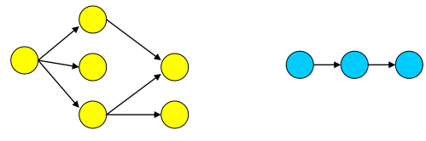
Heap Sensitivity
Heap allocations performed by malloc(), calloc(), mmap(), etc.
Heap merged
  all heap locations represented by same node in PAG
• Allocation site (any call to malloc/calloc)
  Consider each to be a unique location
  Doesn’t differentiate between multiple objects allocated by the same allocation site
Shape analysis
  Recognize linked lists, trees, DAGs, etc.

Slide 29
Aggregate Modeling Options
Arrays
  Elements are treated as individual locations (sensitive)
  Treat entire array as a single location (insensitive)
void foo() {
int a, b, c,d;
int* arr[4];
arr[0] = &a;
arr[1] = &b;
arr[2] = &c;
arr[3] = &d;
int *q = arr[3];
}
Array sensitive analysis:
Pts(arr[0]) = {a}
Pts(arr[1]) = {b}
Pts(arr[2]) = {c}
Pts(arr[3]) = {d}
Array insensitive analysis:
Pts(arr[0]) = Pts(arr[1]) = Pts(arr[2]) = Pts(arr[3]) = {a,b,c,d}

Slide 30
Aggregate Modeling Options
Structures
  Elements are treated as individual locations (“field sensitive”)
  Treat entire structure as a single location
struct Object {
int *p1;
int *p2;
int *p3;
};
struct Object o = {&a, &b, &c};
int* q = o.p2;

Slide 31
Flow Sensitivity Options
Flow insensitive
  The order of statements doesn’t matter
    Result of analysis is the same regardless of statement order
  Uses a single global state to store results as they are computed
  Fast, but not very accurate
Flow sensitive
  The order of the statements matter
  Need a control flow graph
  Must store results for each program point
  Improves accuracy

Slide 32
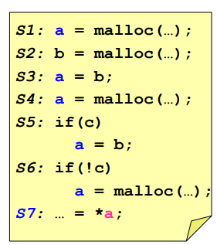
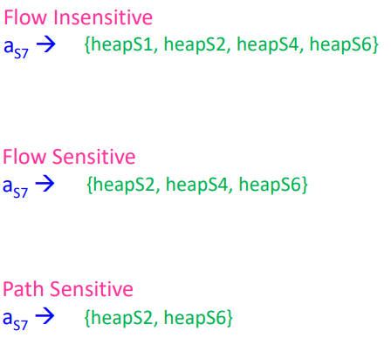
Flow Sensitivity Example
(assuming allocation-site heap modeling)

Slide 33
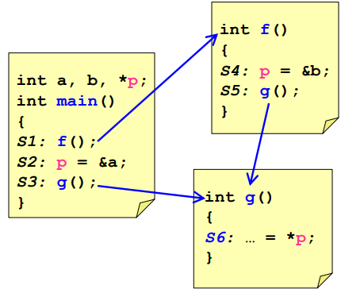
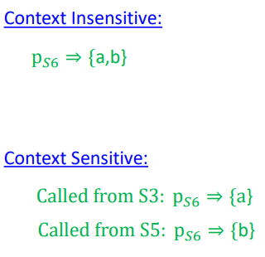
Context Sensitivity Options
Context insensitive/sensitive (interprocedural analysis)
  whether to consider different calling contexts
  e.g., what are the possibilities for p at S6?

Slide 34
Static Pointer Analysis Tools
SVF:
  LLVM based pointer analysis framework
    Supports both flow/context/field insensitive and sensitive analysis
    Supports interprocedural analysis
  Used for detecting bugs [SHIN2019, LEE2020, KIM2020], and automatic software hardening [XUE2019]
Also used within compilers such as LLVM/GCC
  These analysis are mostly intraprocedural

Slide 35
Other Algorithms
Steensgaard’s algorithm
  https://www.cs.cornell.edu/courses/cs711/2005fa/papers/steensgaard-popl96.pdf
  Linear complexity O(n)
  Lower precision than Andersen’s analysis

